Slide 1
CSA1470-COMPILER DESIGN FOR SYNTAX DIRECTED TRANSLATION
CAPSTONE PROJECT ON
A TOOL FOR VALIDATING INPUT STRING USING SLR PARSING TECHNIQUE
Submitted to:
Dr.G.Michael
Project by:
Santhosh I (192211002)
Saravanan R (192211003)
Sai Manu (192225112)

Slide 2
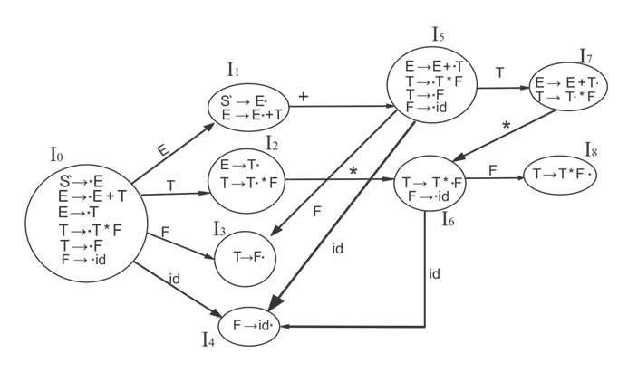
Introduction:
SLR (Simple LR) parsing is a robust and efficient bottom-up parsing technique widely used in compiler design for syntax analysis.
It validates input strings by ensuring they conform to the rules defined in a context-free grammar.
SLR parsers leverage a systematic approach involving parsing tables and a stack to manage the parsing process.
By reading input symbols from left to right, SLR parsers construct a rightmost derivation in reverse, determining if the input can be generated by the grammer.
Overall SLR parsing plays a crutial role in the initial phases of compiler design,ensuring code syntax validity before further semantic analysis and code generation.
The image is the example of the SLR parsing in compiler design

Slide 3
Requirements:
To implement SLR (Simple LR) parsing, several key tools and components are required. These tools facilitate the construction of parsing tables, the management of grammar rules, and the execution of the parsing process:
1.Grammer definition:
Context-Free Grammar (CFG): The foundation of SLR parsing is a well-defined context-free grammar, which includes a set of production rules that describe the syntactic structure of the language.
2. Construction of Parsing Tables
LR(0) Automaton: Used to construct the canonical collection of LR(0) items, which are the building blocks for creating the parsing tables.
SLR Parsing Table Generator: This tool generates the action and goto tables from the LR(0) automaton.
3. Data Structures
Stack: Used to keep track of the parsing states and symbols during the parsing process.
Input Buffer: Contains the string to be parsed and is read from left to right.
Action Table: Guides the parser on whether to shift (read the next input symbol and push it onto the stack), reduce (apply a production rule), or accept (successfully parse the input string).

Slide 4
4.Algorithms
LR(0) Item Construction Algorithm: Generates LR(0) items and builds the canonical collection of these items.
SLR Parsing Algorithm: Utilizes the action and goto tables to parse the input string. The algorithm includes:
Initialization: Setting up the initial state on the stack and the input buffer.
Parsing Loop: Iteratively performing actions (shift, reduce, accept) based on the parsing tables.
5. Auxiliary Tools
Lexer (Lexical Analyzer): Converts the input string into a sequence of tokens. Although not part of the SLR parser itself, a lexer is essential for preprocessing the input.
Error Handling Mechanisms: To detect and report syntax errors encountered during parsing.

Slide 5
How it works
1.Define a grammer:
The context free grammer should have the following:
Terminal:it is also called as token(eg:id,+,*)
Non-terminal:(example:E,T,F)
Production rules:E->E+T
2. Generate LR(0) Items
LR(0) items are used to build the states of the parser. An LR(0) item is a production rule with a dot (.) indicating the position of the parser
3. Construct the Canonical Collection of LR(0) Items
Create the set of all LR(0) items and organize them into states. The closure and goto functions are used to generate these states:
Closure: Expands an LR(0) item by adding items for each production that can follow the dot.
Goto: Moves the dot past a symbol to form a new LR(0) item and transitions to a new state.

Slide 6
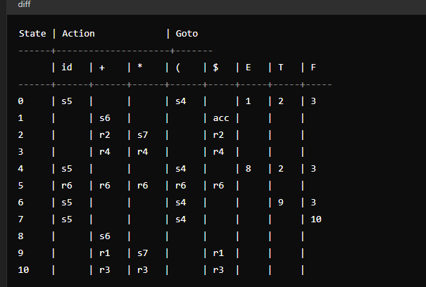
4.Build the Parsing Tables
From the canonical collection, construct the action and goto tables
Action Table: Specifies whether to shift, reduce, accept, or report an error based on the current state and input symbol.
Goto Table: Specifies state transitions for non-terminal symbols after reductions.
S5:shift and goto state 5
R1:reduce using production 1
Acc:accept the input string
5. Parsing Process
Initialization:
Stack:[0] initial state
Input buffer:contains the input string followed by $
Parsing loop
It has following commands
Shift,reduce,accept and error

Slide 7
Advantages of slr parsing
Efficiency
SLR parsing is efficient in terms of both time and space. It constructs parsing tables once, which are then used to parse any number of input strings.
2. Error Detection and Reporting
SLR parsers are capable of detecting syntax errors in the input string. When an error is encountered, the parser can provide meaningful error messages indicating the position and nature of the error.
3. Scalability
SLR parsers are scalable. They can handle large input strings and complex grammars without a significant increase in parsing time.
4. Automatability
SLR parsing is highly automatable. Tools like Bison or Yacc can automatically generate SLR parsers from a given grammar.

Slide 8
conclusion
SLR (Simple LR) parsing stands out as an efficient, deterministic, and highly automatable technique for syntax analysis, making it an invaluable tool in compiler design. Its ability to handle a broad class of context-free grammars without requiring backtracking ensures both speed and reliability in parsing complex language constructs. The clear and systematic methodology of SLR parsing, coupled with robust error detection capabilities, simplifies the process of validating input strings and constructing accurate syntax trees. Moreover, the availability of tools like Bison and Yacc, which automate the generation of SLR parsers, significantly reduces manual effort and minimizes errors. These features, along with its scalability and support from extensive libraries, underscore the advantages of SLR parsing, making it a preferred choice for developers and compiler designers alike. Whether dealing with programming languages or data formats, SLR parsing provides a structured and effective approach to syntax validation, ensuring both precision and efficiency in the parsing process.

